Slide 1
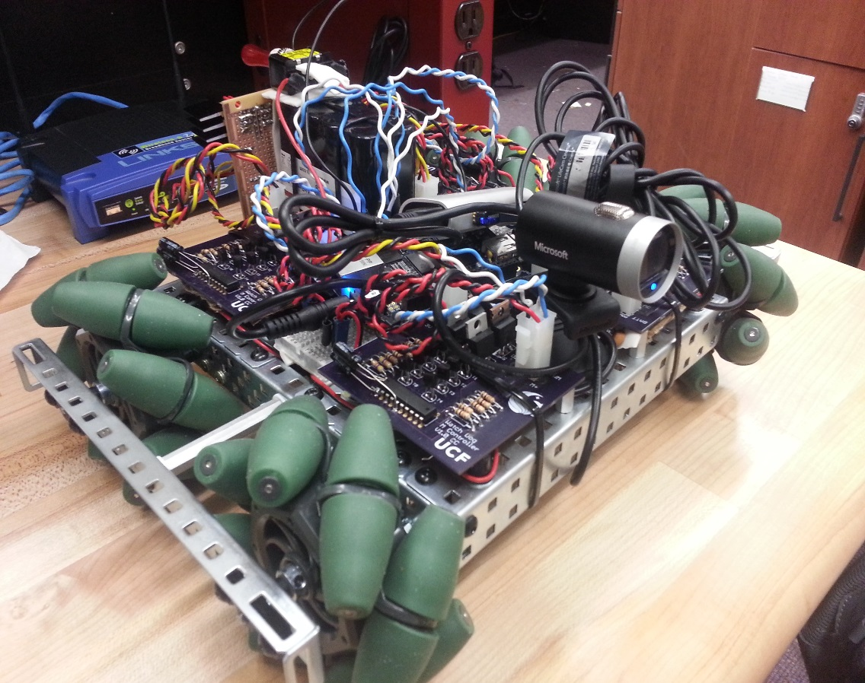
GROUP #4 Chris Carmichael, EE Ismael Rivera , CpE Journey Sumlar, EE Warayut Techarut, CpE
T-100 WATCHDOG

Slide 2
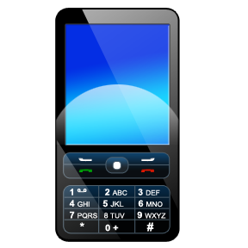
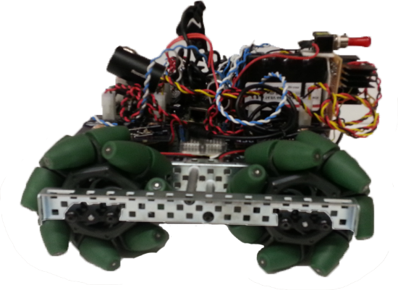
Project Introduction
Detect Motion
Track Movement
Alert User
Remote Control
Streams Video
Camera View

Slide 3
Project Goals
System Integration
Motor Control
Computer Vision
Wireless Communication
Power Control

Slide 4
Requirements
Autonomous
Detect Motion
Wireless Communication
Video Streaming

Slide 5
Specifications
Feature | Measurement
Dimension | 12” x 8”
Operating Range | 25 ft
Power Supply Voltage | 14.4 v
Maximum Weight | 20 lbs
Minimum Acceleration | 1 ft/s²
Maximum Speed | 3 ft/s
Battery Life | 3 hrs
Recharge Time | < 4 hrs

Slide 6
Block Diagram

Slide 7
System on Chip (SoC)

Slide 8
Raspberry Pi vs BeagleBone Black
Raspberry pi
Beaglebone black
$35.00
700 MHz ARM1176JZFS
512 MB SDRAM @ 400 MHz
8 GPIO Pins
$45
1GHz TI Sitara AM3359 ARM Cortex A8
512 MB DDR3L @ 400 MHz
65 GPIO Pins

Slide 9
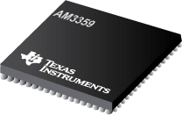

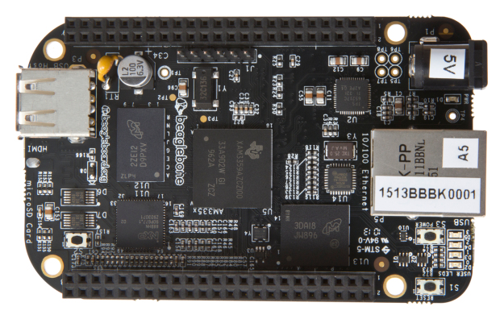
Microcontroller & Development Board
ARM Cortex A8
TI Sitara AM3359
BeagleBone Black

Slide 10
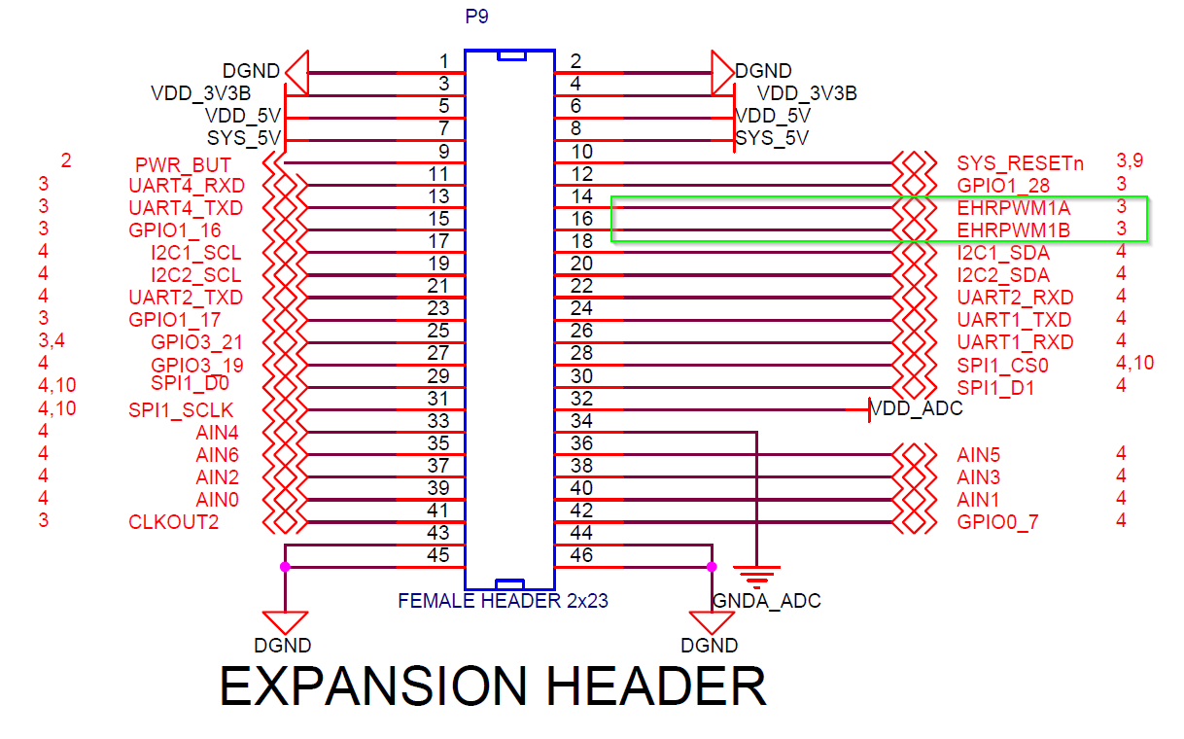
Microcontroller & Development Board

Slide 11
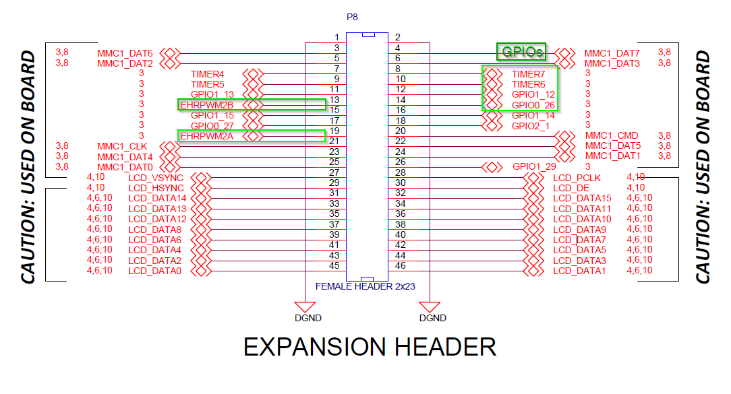
Microcontroller & Development Board

Slide 12



Operating Systems
Debian
Default OS
ArchLinux|ARM
Most Lean
Windows Embedded
Most Integrated

Slide 13
Wi-Fi

Slide 14
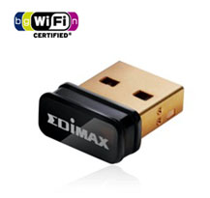
Wi-Fi
Edimax EW-7811Un
IEEE 802.11b/g/n
Compatible with Linux
Small size
Internal Antenna
WEP/WPA/WPA2/WPS Compatible
14.9 mm
7.1 mm
18.5 mm

Slide 15
Computer Vision

Slide 16
Open Source Libraries
Robot Operating system (ROS)
Open Source Computer Vision Library (OpenCV)
Implementations for specific tasks.
Not as big as OpenCV.
Requires OpenCV for certain algorithms.
C++ and JAVA implementations available.
Compatible with multiple distributions of Linux.
Large amount of tutorials and support community .

Slide 17
Computer Vision - OpenCV
Detect movement
Recognize and track a moving person
OpenCV 2.4.2
Optimized computer vision functions and algorithms
Built-in Object Detection and Tracking functions
ARM Support
Performance varies on functions being utilized.

Slide 18
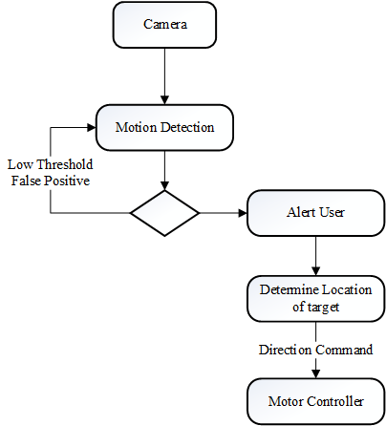
Computer Vision State Diagram

Slide 19

640
0 – 212 LEFT | 213 – 425 STAY | 426 – 640 RIGHT
480

Slide 20
Server & Streaming

Slide 21
Server & Streaming
Node.js
Enable internet HTTP communication
Web GUI (Optional)
Lightweight on resources under load
UDP (User Datagram Protocol)
JAVA Implementation (Android Compatible)
Always listening for incoming commands from mobile phone
Very lightweight on resources
Port specific

Slide 22
Server & Streaming
MJPG-Streamer
Streams images from a folder over the internet
Stream and Snapshot functions available
Android compatible stream
Low resource usage

Slide 23
Streaming State Diagram

Slide 24
Webcam

Slide 25
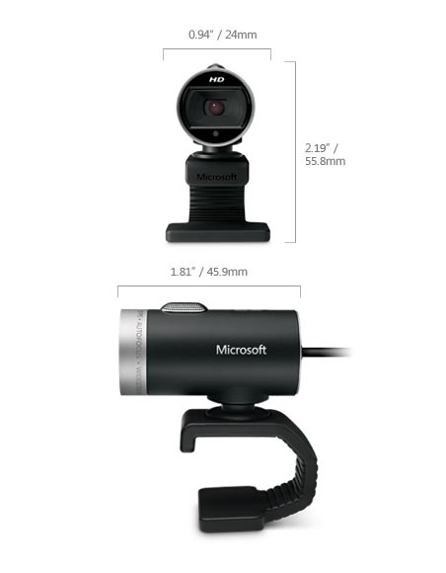
Webcam
Microsoft - LifeCam Cinema
USB 2.0 Connectivity
Linux Compatible
Multiple picture/video resolutions available
Notes:
Compare with others

Slide 26
Mobile Application

Slide 27
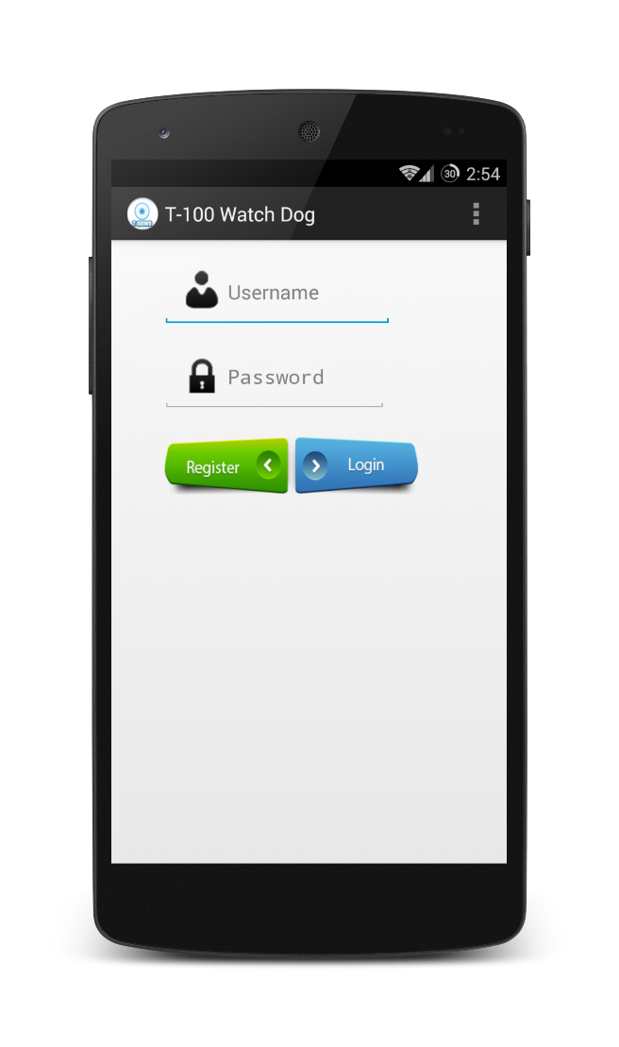
Mobile Application
Support Android 4.0 and newer versions
SQLite Database to store user credentials
Control vehicle remotely
View a live video feed
Store snapshot on the device

Slide 28
Mobile Application State Diagram

Slide 29
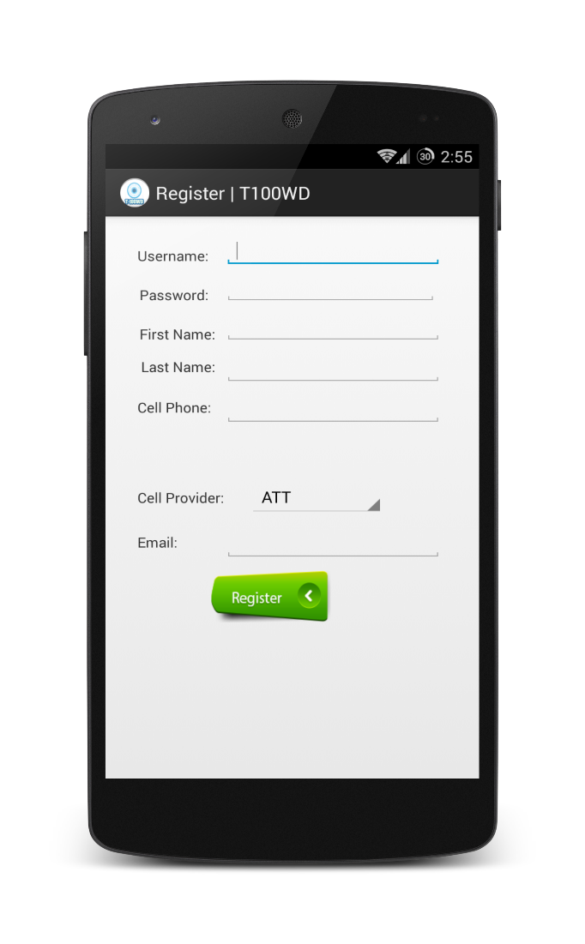
Mobile Application
Registration Activity
Allow user to register a username/password combination.
Store cell phone for SMS and MMS alerts.
Supports: AT&T, Sprint, T-Mobile, Verizon, MetroPCS, Boost Mobile, Straight Talk.
Store email for email alerts.
Send SMS, MMS, and Email address to external server via PHP Post/Get method.

Slide 30

Mobile Application
Login Section
Allows user to register/login
Only authorized users will have access
Performs an Internet Check

Slide 31
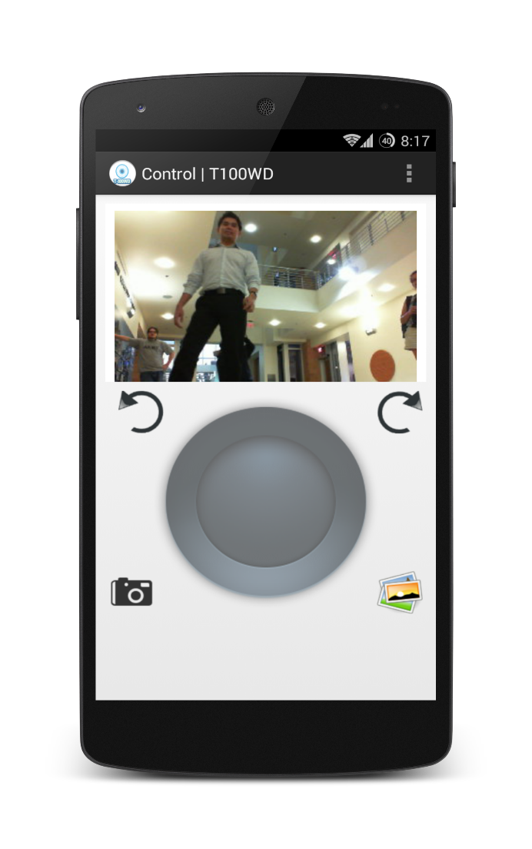
Mobile Application
Control Section
View live video feed
Control robot with virtual joystick
Store snapshot

Slide 32
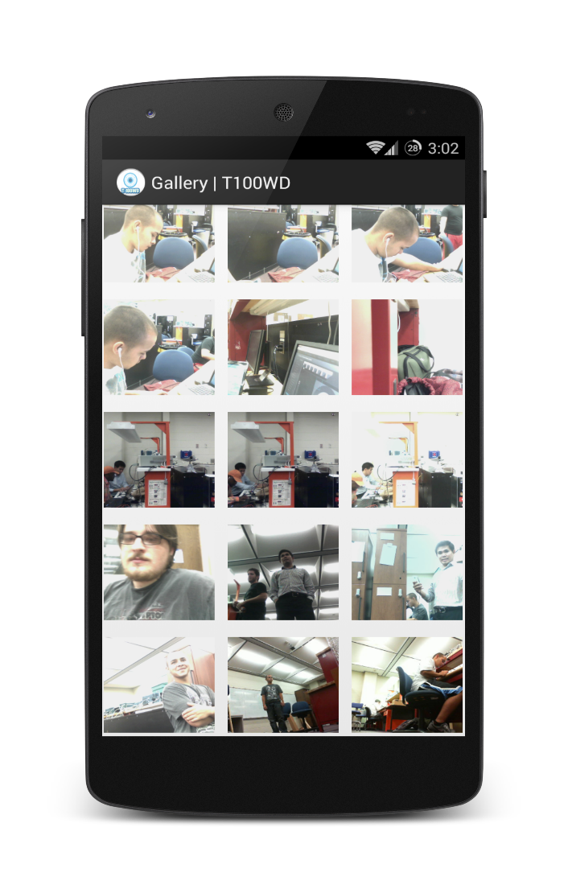
Mobile Application
Gallery Section
View snapshots stored on device
Share via Email/MMS

Slide 33
Motor Controller, Motors, & Wheels

Slide 34
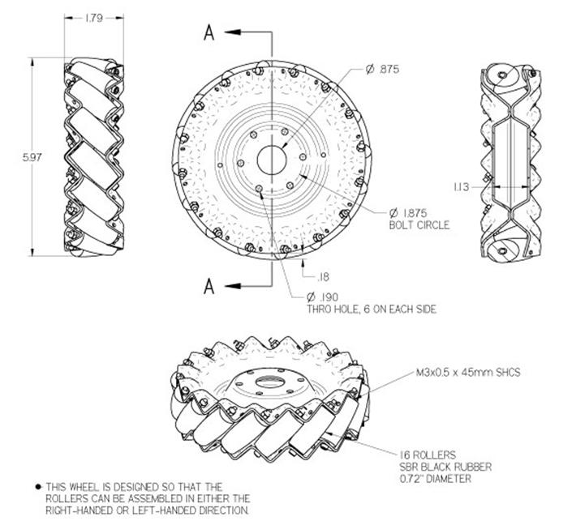
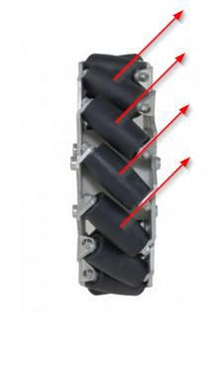
Mecanum Wheels
Notes:
Add Diagrams

Slide 35
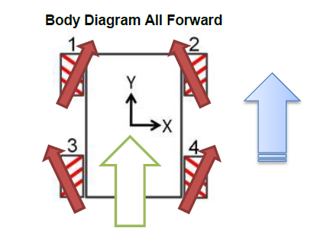
Mecanum Wheels
Notes:
Add Diagrams

Slide 36
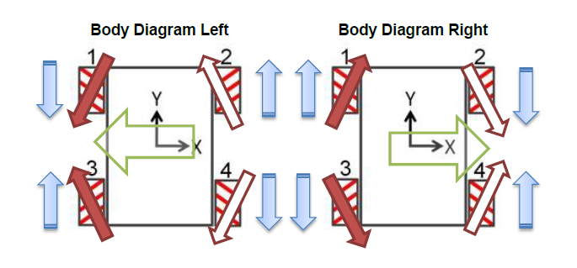
Mecanum Wheels
Notes:
Add Diagrams

Slide 37
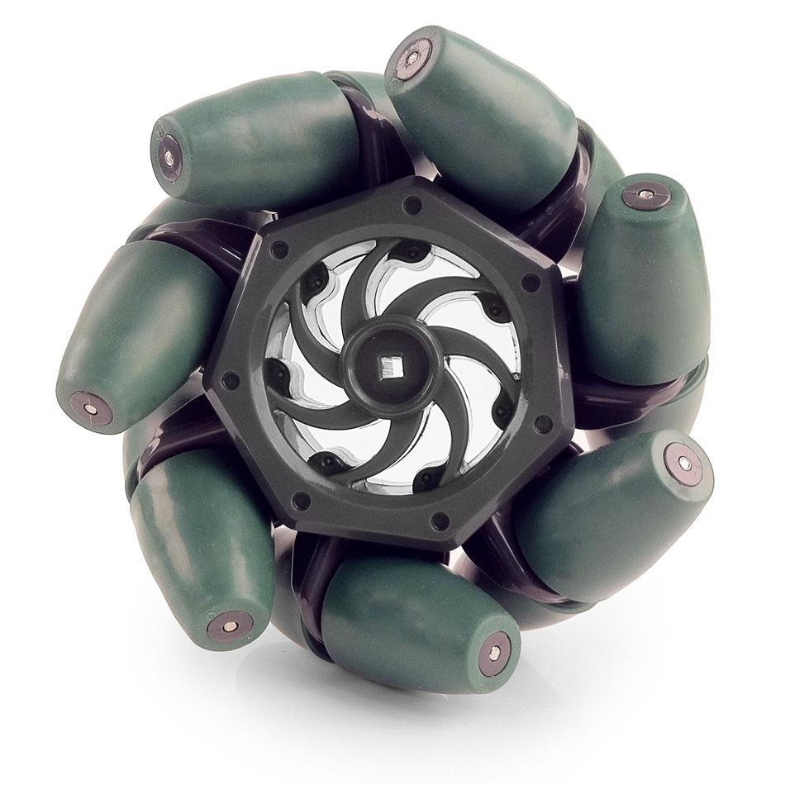
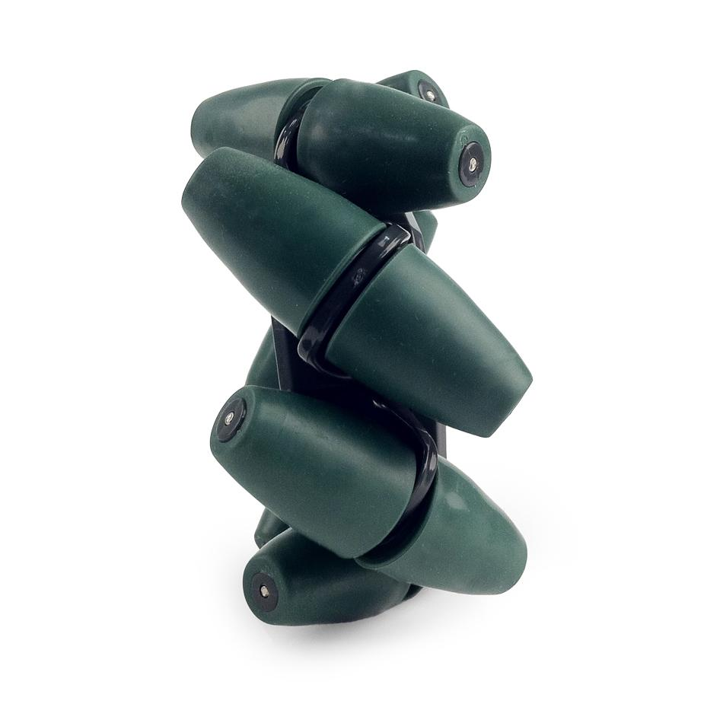
Mecanum Wheels
Vex Robotics Mecanum Wheels
Affordability
$59.99 4 pack
Diameter: 4 in.
Thickness: 2 in.

Slide 38
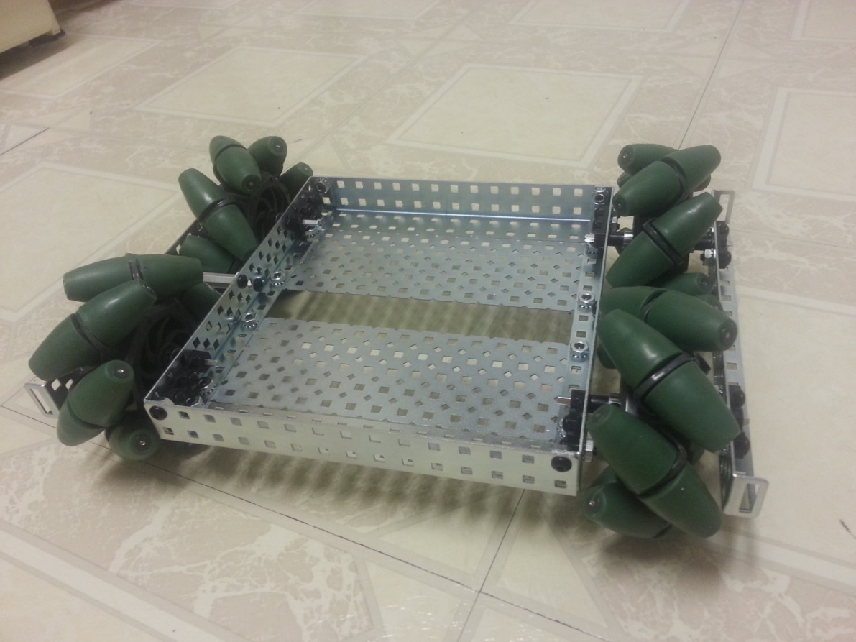
Platform
Perforated Aluminum – Lightweight
2 pounds with wheels included
Easily Adjustable
12 in.
8 in.

Slide 39
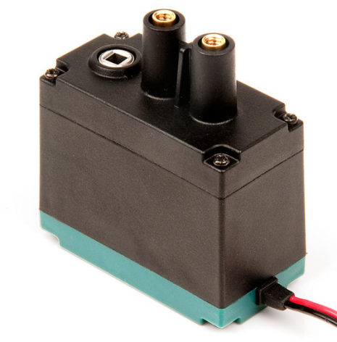
Motor
VEX 2-Wire motor 393 | Requirements | Specs-Low Speed | Specs- High speed
Price | < $20 | $14.99 | $14.99
RPM’s | 130 | 100 | 160
Torque | 1.3 Nm | 1.67 Nm | 1.04 Nm
Weight | < .5 lbs | .2 lbs | .2 lbs
Stall current |  | 4.8 A | 4.8A
Max Power | All measured at 7.2 V | 34.56 W | 34.56 W
2 in.
1.5 in.
1 in.
VEX 2-Wire motor 393

Slide 40
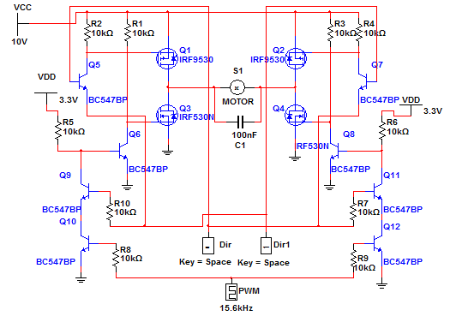
H-Bridge Circuit

Slide 41
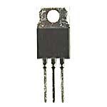
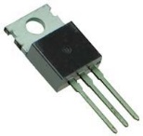
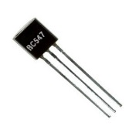
H Bridge Components
IRF 9530 P-Channel | IRF 530 N-Channel | BC547
100 Vds | 100 Vds | 47 V Breakdown
12 A | 14 A | 100 mA
$1.29 | $1.03 | $0.20
10 K OHM Current Limiting Resistors

Slide 42
Controller Budget
Component | How many | Price per unit | Total
MSP430G2552 | 4 | $2.79 | $11.16
IRF9530 | 8 | $1.29 | $10.32
IRF530 | 8 | $1.03 | $8.24
BC547 | 32 | $0.20 | $6.40
Capacitor(100nF) | 4 | $.05 | $0.20
Resistor (10k) | 40 | $.04 | $1.60
Total: (without pcb) |  |  | $37.92

Slide 43
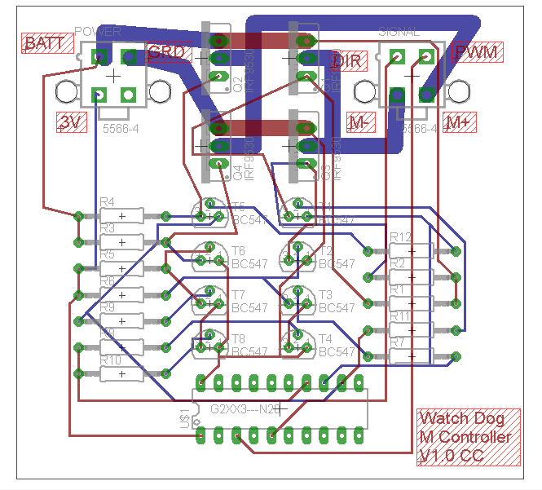
Motor Controller- PCB
Specifications
3”x3”
Thick Traces for high current lines
2 layer
Oshpark, $5/sq in. 3 PCB’s per order.

Slide 44
USB Power Hub

Slide 45
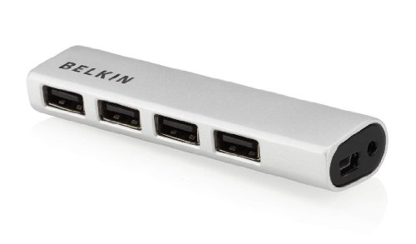
USB Power Hub
BeagleBone Black only has 1 USB port.
2.0 USB Ports
Input voltage is 3-5V
Constant power to each USB port
Weight 8 oz.
1 in.
.5 in.
6 in.

Slide 46
Power Management & Battery

Slide 47
Single Power Supply or Multi Power Supply?
Multi power supply to power all components
Battery Characteristics
High discharge Rate
No/low Memory Effect
Light Weight
High Capacity
Price Effective
High Nominal Voltage

Slide 48
Battery Specifications
Top three candidates for batteries
Most important aspects are Capacity, Discharge Rate, and Voltage
Model | 31604 | 31038 | 18650
Brand | Tenergy | Tenergy | Supower
Capacity (mAh) | 1600 | 4400 | 2200
Voltage (V) | 7.4 | 14.8V | 7.4
Weight (Ib) | 0.2 | 1.2 | 0.2
Discharge Rate (C) | 20 (32 A) | 25 (60A) | 2.5 (5.5A)
Price ($) | 24.5 | 59.99 | 17.99
Chemistry | Lipo | Li-on | Li-on

Slide 49
Battery Selection Motor Controller
Model | 31604 | 31038 | 18650
Brand | Tenergy | Tenergy | Supower
Capacity (mAh) | 1600 | 4400 | 2200
Voltage (V) | 7.4 | 14.8V | 7.4
Weight (Ib) | 0.2 | 1.2 | 0.2
Discharge Rate (C) | 20 (32 A) | 25 (60A) | 2.5 (5.5A)
Price ($) | 24.5 | 59.99 | 17.99
Chemistry | Lipo | Li-on | Li-on
Tenergy 14.8V 4400mAh Battery
Weighs the most but supply the most current out of the batteries.
Expected Battery Life needs to be at least 3 Hours

Slide 50
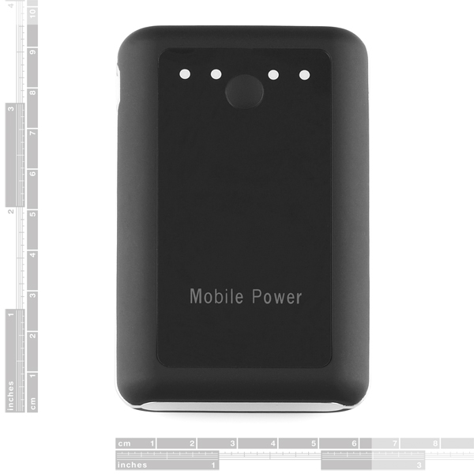
Battery Selection Microcontroller
USB Powered Battery
7.4V Lithium Ion 6600mah
Two output ports
5V at 1A
5V at 2A
Powers off automatically once the devices are disconnected.

Slide 51
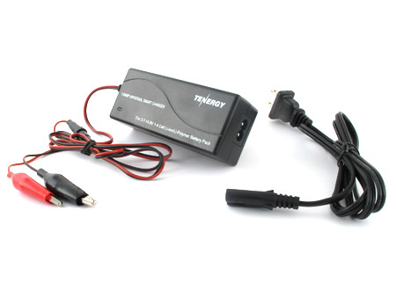
Battery Charger
Tenergy TLP-2000 Smart Charger
Built in Balancer
Price $25.99
Powers both Lion and LIPO batteries.
Led Indication Status on when battery is charging and when the battery is fully charged
Cuts off once battery is fully charged.

Slide 52
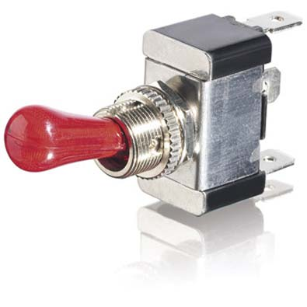
SPST 12VDC/30A Switch
Rated at 12V 30A
Red LED illuminates while on
Great to Conserve Battery life
Nickel plated brass
1.25”
2.5”

Slide 53
Power Requirements
Items | Voltage input needed | Current input needed
BeagleBone Black | 5 V | 2 A
Motor Controllers | 10 V | 16 A
Conventional Webcam | 3 V | <500 mA
MSP 430 | 3.3 V | .5 mA
Wi-Fi Adapter | 3 V | <500 mA
USB Power Hub | 3-5 V | 1.5 A

Slide 54
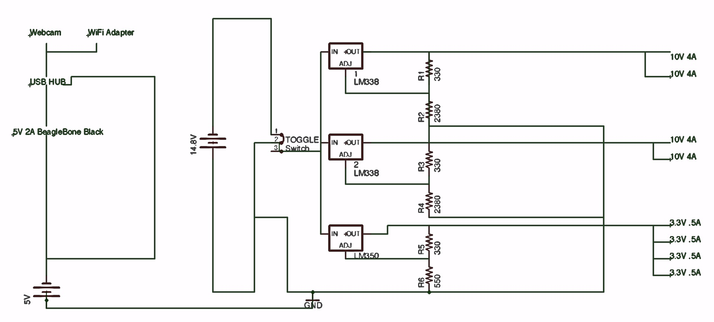
Power System

Slide 55
Voltage Regulators
LM 338
Output Voltage range is 1.2V to 32V
Output current Max 5A
Output voltage is 10V
Heatsinks Needed
2 regulators
LM 350
Output Voltage range is 1.2V to 32V
Output current Max 2A
Output voltage is 3.3V
Heatsinks Needed
1 regulator

Slide 56
Work Breakdown
Task | Ismael Rivera | Warayut Techarut (Wye) | Journey Sumlar | Chris Carmichael
Motor Controller |  |  |  | X
Power Management |  |  | X
Server | X
Computer Vision | X | X
Mobile Application | X
Microcontroller Communication |  | X

Slide 57

Budget & Finance
Part Name | Quantity | Price (each) | Total
Wifi USB Adapter | 1 | $5.99 | $5.99
MicroSD Card | 1 | $7.99 | $7.99
USB AC Powered Hub | 1 | $7.99 | $7.99
Motor | 5 | $14.99 | $74.95
Mecanum Wheels | 1 | $59.99 | $59.99
Robot Frame kit | 1 | $79.99 | $79.99
Motor controller PCBs | 2 | $43.95 | $87.90
Motor Controller Parts | 1 | $46.00 | $46.00
22 guage wire set | 1 | $20.00 | $20.00
Wire connectors | 1 | $40.00 | $40.00
Barrel jack connectors | 2 | $2.95 | $5.90
USB Battery | 1 | $29.95 | $29.95
Battery + Charger | 1 | $88.55 | $88.55
BeagleBone Black | 1 | $62.71 | $62.71
Miscellaneous |  |  | $50
 |  | Total | $667.91
 |  | Over budget | $42.54

Slide 58
Issues
Low performance for OpenCV (1-2 frames per second)
Driver not fully compatible
Faster Processor
UCF Network Restrictions
Time constraints
Budget

Slide 59
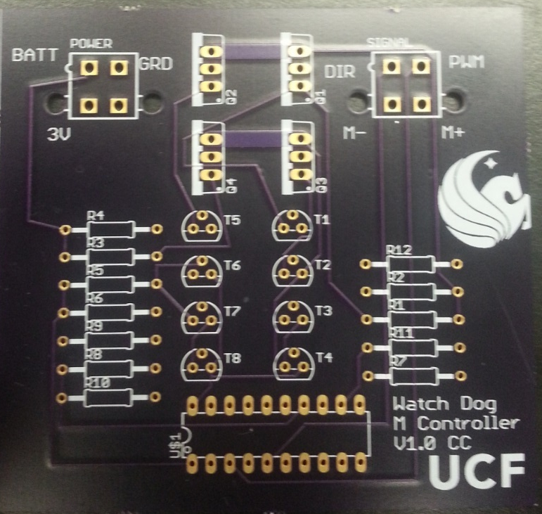
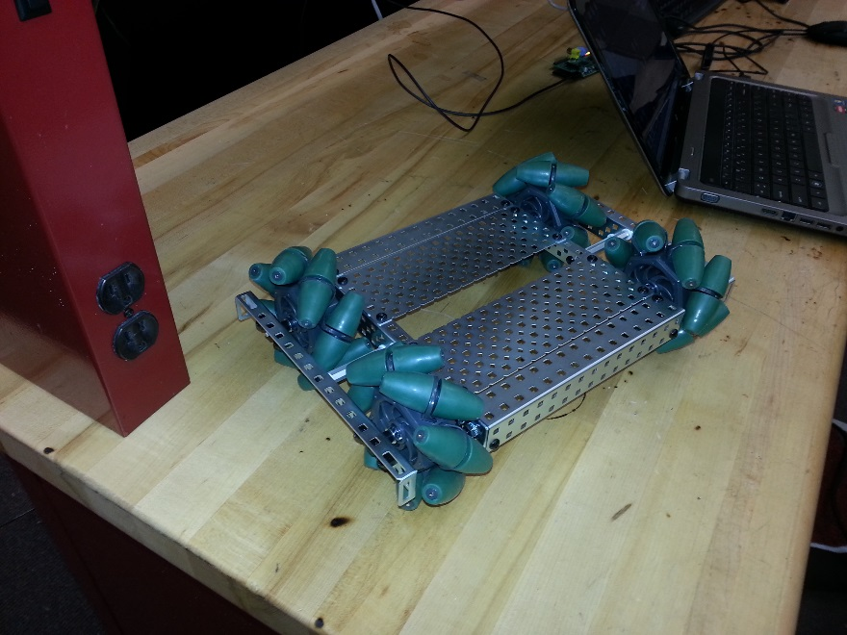
Project Process

Slide 60
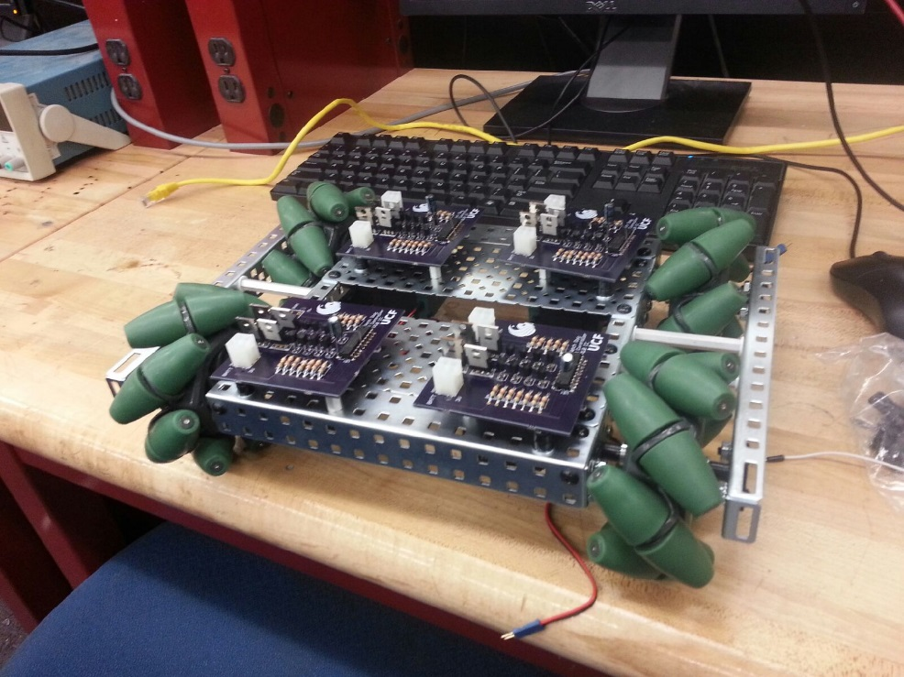

Project Process

Slide 61
GROUP #4 Chris Carmichael Ismael Rivera Journey Sumlar Warayut Techarut
Questions?

